Slide 1
Risk Management
SE423: Software Project Management

Slide 2
Outline
Risk Management Process
Risk Identification
Risk Analysis
Risk Planning
Risk Monitoring

Slide 3
Risk Management Process

Slide 4
What is a Risk?
Problems that haven’t happened yet
Characterized by:
Uncertainty (0 < probability < 1)
An associated loss (money, life, reputation, etc)
Manageable – some action can control it
Needs to be actively identified and managed
Some choose to ignore – seen as negativity or too much worry
Is a key element in project decision making – especially important for the tough decisions
Proactive vs. Reactive
Active Risk Management is a sign of a well-run project and a mature organization

Slide 5
What is a Risk?
According to the PMBOK Guide:
“Project risk is an uncertain event or condition that, if it occurs, has a positive or negative effect on one or more project objectives.”
“A risk may have one or more causes, and, if it occurs, one or more impacts”
Project Risks
What can go wrong?
What is the likelihood?
What will the damage be?
What can we do about it?

Slide 6
Risk Classification
Requirements Risks
Incorrect
Incomplete
Unclear or inconsistent
Volatile
Cost Risks
Unreasonable budgets
Schedule Risks
Schedule compression (customer, marketing, etc.)
Quality Risks
Life Cycle / Operational Risks
Most of the “Classic Mistakes”

Slide 7
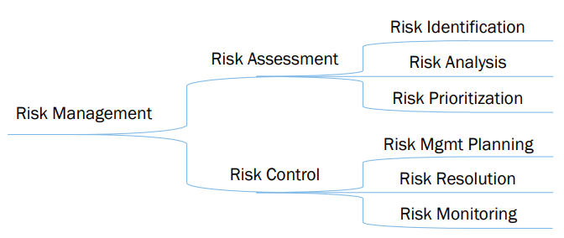
Risk Management Process
Risk management is a systematic approach to reducing the harm due to risks, making a project less vulnerable to challenge or failure and its resulting product more robust
Understanding the hierarchy of Risk Management = Understanding risks and how to deal with them

Slide 8
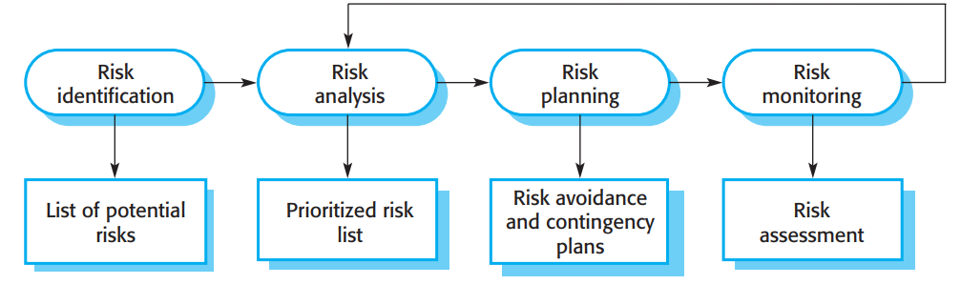
Common project, product, and business risks

Slide 9
Risk Identification

Slide 10
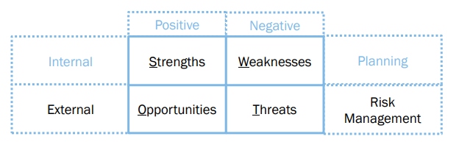
Risk Identification
Get the team involved in this process
Don’t go it alone
Produces a list of risks with potential to disrupt your project’s cost or schedule
Use a checklist or similar source to brainstorm possible risks
Use a SWOT analysis process

Slide 11



Risk Categories
Types
Classification
Source
Internal / Unique Classifications and Sources

Slide 12
Risk Analysis

Slide 13
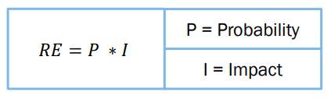
Risk Analysis
Numerical analysis of risk allows:
Make response decisions
Determine overall project risk
Add probability to predictions
Prioritize risks
Factor risk into cost, schedule, or scope targets
Calculating Risk Exposure

Slide 14
Risk Analysis
Risk Exposure Examples
“Facilities not ready on time”
Probability is 25%, size is 4 weeks, RE is 1 week
“Inadequate design – redesign required”
Probability is 15%, size is 10 weeks, RE is 1.5 weeks
How to Estimate
Impact: The size of the loss – break into chunks
Probability:
Use team member estimates and have a risk-estimate review
Use Delphi or group-consensus techniques
Use gambling analogy” “how much would you bet”
Use “adjective calibration”: highly likely, probably, improbable, unlikely, highly unlikely
Sum all RE’s to get expected overrun

Slide 15
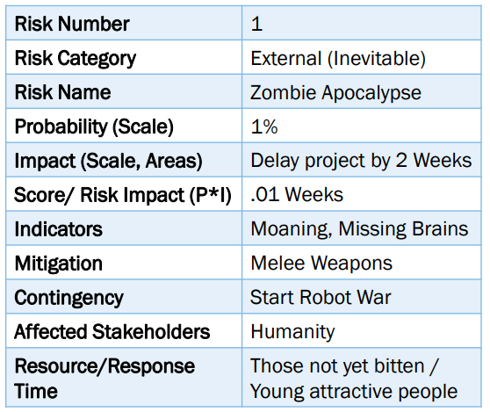
Risk Prioritization
Remember the 80-20 rule
Often want larger-loss risks higher
Or higher probability items
Possibly group ‘related risks’
Helps identify which risks to Ignore
Those at the bottom
Use Risk Register

Slide 16
Risk Planning

Slide 17
Risk Management Planning
Risk analysis and planning should continue throughout the project
Risks can be eliminated, but impact analysis should be completed first
Develop risk response strategies

Slide 18
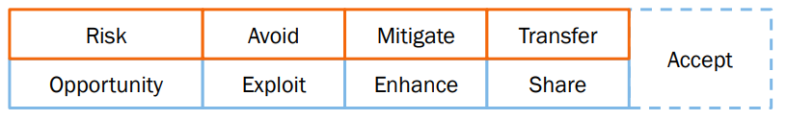
Risk Resolution
Risk Avoidance
Don’t do the project at all
Scrub from system
Off-load to another party
Problem control
Develop contingency plans
Allocate extra test resources
Knowledge Acquisition
Investigate/ research
Buy information or expertise about it
Risk Transfer
To another part of the project (or team)
Move off the critical path

Slide 19
Risk Monitoring

Slide 20
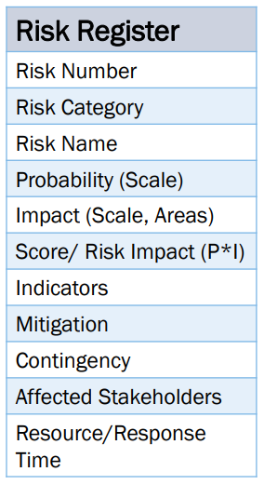
Risk Monitoring
Top 10 Risk List
Rank
Previous Rank
Weeks on List
Risk Name
Risk Resolution Status
A low-overhead best practice
Interim project post-mortems
After various major milestones
Communicate w/ Stakeholders!

Slide 21
Monitor and Control Risks
Concepts
Workarounds – unplanned corrective action for unanticipated problems
Risk Reassessments – periodic risk review and adjustments
Risk Audits – proves risk preparedness and provides lessons learned
Reserve Analysis – accounting for risk reserves (financial and schedule), which are only for risk
Status Meetings – should primarily focus on risks
Closing Risks – the conditions surrounding a risk are in the past, and the risk should be closed
Outputs: Risk Register Updates, Change Requests, PM Plan Updates, Project Document Updates, Lessons Learned

Slide 22
Miniature Milestones
Use of small goals within project schedule (1-2 days)
Reduces risk of undetected project slippage
Requires a detailed schedule, including early milestones
Use binary milestones (done or not done)
Pros
Enhances status visibility
Good for project recovery
Can improve motivation through achievements
Encourages iterative development
Cons
Increase project tracking effort

Slide 23
Basic principles
Risks must be managed
Risk must always be one of the principle concerns of the project management team
Risks must be reported
Risks should be an agenda item in weekly team meetings
Risks should be included in the project status report
Weekly project review should review all risks
Team meeting
Should briefly review all outstanding risks
Should estimate whether each risk’s probability has increased, has decreased, or is unchanged
Risk owners should report on their assigned risks

Slide 24
Basic principles
In the project status report, list all risks for which the degree of risk has changed
Weekly project review
Review all risks, even those that have been eliminated
Goal is to uncover new risks or identify those that have been reincarnated
Reviewing risks in weekly team meetings keeps the team and risk owners aware and sensitized to risks
Including risks in the project status report prepares management for the time(s) when risks happen

Slide 25
Seven Principles
Maintain a global perspective
Take a forward-looking view
Encourage open communication
Integrate
Emphasize a continuous process
Develop a shared product vision
Encourage teamwork

Slide 26
Risk Management Conclusion
Avoid Common Errors
Risk Management should be the focus of Status Meeting
Risk Management is often not used in Project Management, but has high ROI
Risks are both good and bad
Funds/time set aside for risks are necessary
Communicate

Slide 28
Reality check for your project plan
Testing the plan before you begin
Assessing the project using risk management
Involving the team in planning
Building confidence for your plan
Selling the plan to relevant stakeholders

Slide 29
Risk Management
Notes:
http://en.wikipedia.org/wiki/Murphys_law
Also,
http://www.murphys-laws.com/murphy/murphy-true.html
For a list and corollaries:
http://www.murphys-laws.com/murphy/murphy-laws.html
http://www.nova.edu/~shanbhag/humor/Gumpersons-Law.html
Dr. R.F. Gumperson, internationally famous physicist, began serious work in 1938 on a phenomenon long known to scientists, but up until then considered as a mere curiosity. This was the fact that the forecasting record of the Weather Bureau, despite its use of the most advanced equipment and highly trained personnel, was not as good as that of the Farmers' Almanac. After four years of research, Dr. Gumperson enunciated his now famous law and was able to make a series of predictions later confirmed by other workers in the field.
There is no knowing to what further glittering heights Dr. Gumperson’s genius could have led him had it not been for his untimely death in 1947. Strolling along the highway one evening, he was obeying the pedestrian rules of walking to the left, wearing light clothing, and facing traffic. He was struck down from behind by a Hillman-Minx, driven by an English visitor hugging the left side of the road.

Slide 30
Black Swans
Risk management: There are no black swans
The March 2011 earthquake and tsunami and crisis with the nuclear plant.
Could not happen
Sea walls were tall enough
Historical record says otherwise
Generators were ready
Assuming no tsunami could hit
BP Oil spill in April 2010
Blow out preventer would work
Known problems
Management was on top of the problems
“Excellent record of safety”.

Slide 31
What can Possibly Go Wrong?
Consider the “average” college student:
What risks does the student encounter? How can we mitigate the damage?
Computer related:
Lose file;
Lose flash drive;
Lose hard drive; damaged
Lose computer; damaged, lost or stolen
Crash computer; corrupted files
No network? Cannot access D2L
Attendance and time management
Miss class or late
Late home work submission
Miss home work submission

Slide 32
What can Possibly Go Wrong?
Consider the “average” project:
Testing takes longer than planned – cannot resolve bugs
Vendor cannot deliver a product on schedule
Critical engineer
Has accident (wipes out in ski jump)
Becomes a parent
Has major surgery
Critical engineer leaves project/company
Change of ownership. Project on hold
Major downsizing
Dysfunctional staff
Blizzard and power failures

Slide 33
How to Categorize Risk
Risks: known, unknown, unknowable
Known Risks: Risks that can be uncovered after careful evaluation of the project plan, business and technical environment, and other reliable sources of information (I.e. unrealistic delivery dates, lack of user input, etc.)
Refer to those risks that can be estimated from historical information
Can be mitigated by management techniques and through response plans, should they occur
Example: Potential delay in delivery from third-party vendor
Example: Key personnel leave project
Example: Development systems down

Slide 34
How to Categorize Risk
Predictable Risks [but unknown risks]: Risks that can be extrapolated from past projects. (Staff turnover, poor communication with the customer)
Refer to those risks that we know have a probability of occurring, but do not know the precise impact
Cannot be managed directly but can be mitigated by the use of contingency
Example: Loss of key personnel due to turnover
Unpredictable Risks “Joker” risks that are hard to predict.
Unknowable risks
Refer to those risks that are outside the scope of historical or probabilistic models for the project
Are beyond the scope of risk management and usually are addressed by crisis or disaster management
Examples: Corporate failures, natural disasters, acts of terrorism or war, major snowstorm and power loss

Slide 35
Risk management model (after Taylor)
Risk Management Planning
Risk Identification
Qualitative Risk Analysis
Tracking & Auditing (Risk History)
Evaluate & Revise
Quantitative Risk Analysis
Risk Control
Risk Monitoring
Risk Response Planning

Slide 36
Risk Management Planning

Slide 37
Introduction
Risk Management Planning addresses how to approach, plan, and execute all of the project risk management activities
The risk management plan is critical to the overall risk management process
Risk management plan is an input to every other risk-related process in the Planning Process Group
A well-defined, comprehensive risk management plan enhances the chances of success of the risk management process

Slide 38
Risk identification input
Enterprise environmental factors
Concerned with aspects of the enterprise outside of project
One source may be enterprise historical information
Industry or academic research is another excellent source
Example: The Gartner Reports
comp.risks (Usenet discussion group/mailing list, see reading list)

Slide 39
Input to risk management planning
Enterprise environmental factors
Most critical environmental factors are the risk tolerance levels of the organization and the stakeholders
Risk tolerance expresses an inherent trade-off decision between benefits and cost
Stakeholders will take a risk if the benefits to be gained outweigh what could be lost
Conversely, stakeholder will avoid taking a risk because the cost or impact is too great for the amount of benefit that can be derived

Slide 40
Input to risk management planning
Organizational process assets
Organization may already have policies and guidelines that define its risk tolerance
Project scope statement
Project assumptions, constraints, and initial defined risks in scope statement
The project scope statement contains several information sources for risk management planning:
Project deliverables
Project constraints
Project assumptions
Initial project organization
Initial defined risks
Schedule milestones

Slide 41
Risk identification input
Risk management plan
Risk categories (e.g. as defined in RBS) are primary source of input
Budget and schedule for risk management activities
Project management plan
Project management plan contains schedule, budget, and quality plans which may be sources of risks
Risk management plan becomes an integral part of the project management plan
All other project management processes and guidelines comprising the project management plan should be considered in light of potential risks
Risk management plan should be consistent with the overall direction and management approach of the project

Slide 42
Risk management planning: tools & output
Risk management planning tools
Planning meetings are the main tool for risk management planning
Attendees should include the project manager, members of the project management team, and stakeholders who can contribute risk-related information
Meetings will involve analysis of risk for the project, risk tolerance of the organization, and calibrating risk to the project and organization
Risk management planning output
The risk management plan is the only output from the risk management planning process
Risk management plan is detailed on following slides

Slide 43
Risk management plan content
Methodology. How risk management will be performed, including methods, tools, and sources of data
Roles and responsibilities. Team of people responsible for managing identified risks and responses, the risk ‘owners’
Budgeting. Assign resources and estimate costs of risk management and its methods
Timing. Timing and frequency of the risk management processes
Risk categories. Develop and review during planning. Used in risk identification

Slide 44
Risk management plan content
Definitions of risk probability and impact. Discussed in detail in Qualitative Risk Analysis
Probability and impact matrix. Discussed in detail in Qualitative Risk Analysis
Revised stakeholder tolerances. Risk planning may result in changes in stakeholder tolerance
Reporting formats. Describes the content and format of the risk register, the dictionary of risks for project
Tracking. Describes how the risk activity history will be documented and how risk processes will be audited

Slide 45
Risk categories
Risk categories are identified during risk management planning
Risk categories systematically classify risks and provide a context for understanding those risks
Used in successor process, Risk Identification
Starting point list of risk categories:
Technical, quality, or performance risks
Project management risks
Organizational risks
External risks

Slide 46
Risk categories
Technical/quality/performance risks
Unproven or complex technology
Changes to technology anticipated during the course of the project
Unrealistic quality goals
Unrealistic performance goals
Project management risks
Improper schedule and resource planning
Poor project planning
Improper or poor project management disciplines or methodologies

Slide 47
Risk categories
Organizational risks
Resource conflicts due to multiple projects occurring at the same time in the organization
Unrealistic scope, time, and cost objectives with respect to the organization’s resources or structure
Lack of funding for the project or diversion of funds from the project to other projects
Management oversight changes
Loss of project ‘champion’
Project ‘politics’

Slide 48
Risk categories
External risks
New laws or regulations
Example: Sarbanes-Oxley Act of 2002 (corporate governance and financial practice) – “Compliance should be planned and implemented as a normal project”
Labor issues
Weather
Changes in ownership
Changes in foreign policy for projects performed (all or in part) in other countries
Catastrophic risks (force majeure) are outside the scope of risk management planning – require disaster recovery techniques
Examples: Earthquakes, meteorites, volcanoes, hurricanes, floods, civil unrest, terrorism, etc.

Slide 49
Risk Breakdown Structure (RBS)
Risk categories can be represented visually in a Risk Breakdown Structure (RBS) diagram
Provides hierarchical decomposition of risk categories
Analogous to WBS
Project
Technical
Project Management
Organizational
External
Unproven Technology
Schedule Planning
Project Schedules
Laws & Regulations
Technology Changes
Resource Planning
Unrealistic Objectives
Weather
Complex Technology
Project Disciplines
Lack of Funding
Labor Issues
Quality
Cost Estimates
Management
Catastrophic Risk
Performance
Budgets
After Heldman et al., PMP:Project Management Professional Study Guide

Slide 50
Risk Identification: Introduction
Risk identification is concerned with determining what risks might have an impact on the project
In addition, risk identification seeks to profile risks so that effective mitigation and response planning might be possible
Risk identification is an iterative and incremental process that continually adds new risks, deletes non-risks, and refines existing risk profiles as the project progresses

Slide 51
Where risks are found
Budgets/funding
Schedules
Scope or requirements changes
Project plan
Project management processes
Technical issues
Personnel issues
Hardware
Contracts
Political concerns
Business risk
Legal risk
Environmental risk

Slide 52
Three Types of Software Risk
Project Risks Threaten the project plan. I.e. if the risks materialize, then it is likely that the project schedule will slip and costs will increase.
Budgetary/funding
Schedule
Personnel issues
Resources
Project plan
Project management processes
Customers
Requirements problems – Scope or requirements changes
Project complexity and size.
Hardware
Environmental risk

Slide 53
Three Types of Software Risk
Technical Risks Threaten the quality and timeliness of the software to be produced.
Design
Implementation
Interfacing
Verification
Cutover
Maintenance
Security

Slide 54
Three Types of Software Risk
Business Risks Threaten the viability of the product to be built.
Building a great product that no-one wants anymore. (Market risk)
Building a product that no longer fits into the overall business strategy for the company (Strategic risk).
Building a product that the sales force doesn't understand how to sell.
Losing the support of senior management due to a change in focus or a change in people. (Management risk).
Losing budgetary or personnel commitment (Budget risk)
Contracts
Political concerns
Legal risk

Slide 55
Risk identification: tools and techniques
Documentation reviews
Effectively, a thorough review of all the inputs to the risk identification process
Information-gathering techniques
Brainstorming
With right participants and proper facilitation, brainstorming is a self-regenerating process
Delphi technique
Employs a facilitator who distributes a questionnaire to participants and who compiles and synthesizes results
Participants do not interact directly as they do in brainstorming
Interviews
Uses standard question and answer techniques with various stakeholders or anyone with project-relevant knowledge

Slide 56
Risk identification: tools and techniques
Root cause analysis. Technique helps determine the source of risk
Involves deep analysis of identified risks in order to root out other potential risks
The source of risk may seem superﬁcial and directly visible: simply, the most immediate source
However, often the true source of risk—its root cause—is less obvious and not easily detectable
Hall (1998)* suggests using the ‘Five Whys?’ approach
Ask the question ‘Why?’ ﬁve (more or less) times for each risk
Each successive question moves closer to the root cause
Not a highly robust method, but simple and effective
* Managing Risk: Methods for Software Systems Development. Elaine M. Hall, Addison-Wesley, 1998

Slide 57
Risk identification: tools and techniques
Root cause analysis (cont’d)
Example (based on actual case):
O-O DB vendor is porting O-O DB to (our) new platform and has been identiﬁed as potential schedule risk
Why? Vendor has requested additional time to deliver O-O DB
Why? Vendor did not complete critical intermediate deliverable required for delivery
Why? Vendor was unable to get concurrency (threads) to work properly
Why? Vendor is using design from another platform with different OS
Why? Vendor has no development experience programming with threads
Note that this is a capability issue, not a technical issue!

Slide 58
Risk identification: tools and techniques
Checklist analysis
Based on historical information and previous project team experience – requires one or more similar projects
Risks can be compiled into a checklist
Lowest level of the RBS can be used as a starting point for a checklist
Checklists for projects cannot ever be exhaustive (remember, projects are unique)

Slide 59
Risk identification: tools and techniques
Assumptions analysis
Validates the assumptions identified and documented throughout the project planning processes
Assumptions should be accurate, complete, and consistent
Assumptions are tested against two factors:
Strength or validity of the assumption
Consequences to the project if assumption turns out to be false
False assumptions should be reclassified as risks
Diagramming techniques
Cause-and-effect (fishbone or Ishikawa) diagrams
System or process flowcharts
Influence diagrams

Slide 60
Cause and Effect Diagram
Also known as the Ishikawa (or fishbone) diagram
Show the relationship between the effects of problems and their causes
Depicts every potential cause and sub-cause of a problem and the effect that each proposed solution will have on the problem
Useful as a tool for visually representing and capturing cause-and-effect relationships

Slide 61
Fishbone Diagram

Slide 62
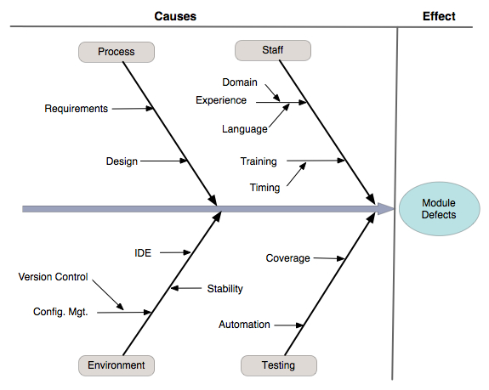
Cause-and-effect diagram

Slide 63
System or process flowcharts
Risk owner notifies PM of event or risk trigger
Decision
symbol
Familiar diagram to most stakeholders
Shows logical steps needed to accomplish an objective
Shows how elements of a process or system relate to each other
Depicts cause/response relationships
Risk response plan executed?
Preparation
symbol
N
Y
Response plan reviewed for effectiveness
Review risk scores
Process
symbol
N
High risk score?
Y
Review risk and risk response plan
Assign resources/
implement response plan
Monitor response plan execution
Termination
symbol
After Heldman et al., PMP:Project Management Professional Study Guide
Document
results

Slide 64
Influence diagrams
Primarily used to show the causal influences among project variables
May also show the sequencing of events
Used to visually depict risks (or decisions), uncertainties or impacts, and how they influence each other
Recall our ‘triple Constraint’ diagram from Lecture 1
Scope
Quality
Cost
Time

Slide 65
Risk Identification Techniques
Identification based on past experience.
Identification based on historical data, perhaps through the use of a project database.
Decision Driver Analysis, where the key decisions are examined for risk. The factors influencing decisions offer possible sources of risk.
Threat identification in security risks

Slide 66
Risk Item Checklist
A checklist is useful for supporting risk identification of known and predictable risks in the following subcategories:
Product size – risks associated with the overall size of the software to be built or modified.
Business impact – risks associated with constraints imposed by management or the marketplace.
Customer characteristics – risks associated with the sophistication of the customer and the developer's ability to communicate with the customer in a timely manner.
Process definition – risks associated with the degree to which the software process has been defined and is followed by the development organization.
Development environment – risks associated with the availability and quality of the tools to be used to build the product.
Technology to be built – risks associated with the complexity of the system to be built and the "newness" of the technology that is packaged by the system.
Staff size and experience – risks associated with the overall technical and project experience of the software engineers who will do the work.

Slide 67
Product Size Risks
Project risk is directly proportional to product size.
Measure the following sizes against previous projects. If those projects were successful & results are similar, then risk is probably low. If a large negative deviation is observed then risk is HIGH.
Estimated size of the product in LOC or FP?
Degree of confidence in estimated size estimate?
Estimated size of product in number of programs, files, transactions?
Percentage deviation in size of product from average for previous products?
Number of users of the product?
Impact on system (loading)
Anticipated volatility of the requirements?
Amount of reused software?

Slide 68
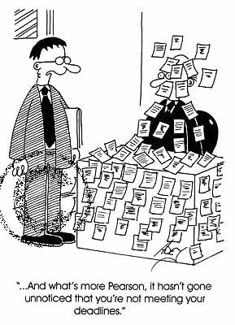
Business Impact Risks
The following items help identify generic risks associated with business impact:
Effect of product on company revenue.
Visibility to senior management.
Reasonableness of delivery deadline
Number of customers who will use the product & consistency of their needs.
Number of other products that it will interact with.
Sophistication of end users.
Governmental constraints.
Costs associated with late delivery or a defective product?

Slide 69
Customer Related Risks
The following items help identify generic risks associated with the customer:
Have you worked with the customer in the past?
Does the customer have a solid idea of what is required?
Is the customer willing to commit significant time to the requirements gathering process?
Is the customer willing to establish rapid communication links with the developer?
Is the customer willing to participate in reviews?
Is the customer technically sophisticated in the product area?
Does the customer understand the software process?
Risks should be investigated if the answer to any of these questions is “NO”.

Slide 70
Process Risks
An ill defined software process and/or an ad hoc approach to analysis, design, and testing can introduce risk.
The following are sample questions that should be asked to identify process risk:
Do you have a consistent repeatable process that is actually used?
Do you train all developers in the process?
Are formal technical reviews part of this process?
Do you have a mechanism for managing change? (i.e. formal RFC system + configuration management).
Do you have specific methods that you use for each phase of the process?
Is the process supported by tools?
Do you manage the process through use of metrics?
Risks should be investigated if the answer to any of these questions is “NO”.

Slide 71
Technology Risks
Pushing the limits of technology is challenging & exciting, yet very risky.
Questions to identify risk include:
Is the technology to be built new to your organization?
Do the requirements require the creation of new algorithms?
Does the software interface with new or unproven hardware or unproven vendor products?
Do the requirements require the creation of components that are unlike anything your organization has previously built?
Do requirements demand the use of new analysis, design, or testing methods?
Do requirements put excessive performance constraints on the product?
Risks should be investigated if the answer to any of these questions is “YES”.

Slide 72
Development Risks
The software engineering environment supports the project team, the process, and the product.
If the environment is flawed, it can be a source of significant risk:
Is a software project management tool available?
Are tools for analysis and design available?
Are compilers and code generators available and suitable for the product to be built?
Are testing tools available and suitable?
Are the software tools integrated with each other?
Are team members trained in the use of the tools?
Are tool mentors available?
Risks should be investigated if the answer to any of these questions is “NO”.

Slide 73
Staff Size and Experience Risks
CEOs have frequently observed that “people” make the most significant difference to the success of the organization.
Are the best people available?
Do the people have the right combinations of skills?
Are enough people available?
Are staff committed for the duration of the product?
Are some people working on multiple projects?
Have staff received necessary training?

Slide 74
Risk Components and Drivers
The US Air Force requires project managers to identify
risk drivers that affect software risk components.
Performance risk – the degree of uncertainty that the product will meet its requirements and be fit for its intended use.
Cost risk – the degree of uncertainty that the project budget will be maintained.
Support risk – the degree of uncertainty that the software will be easy to correct, adapt, and enhance.
Schedule risk – the degree of uncertainty that the project schedule will be maintained and that the product will be delivered on time.

Slide 75
Output: Risk Register
The output of the Risk Identification process is the risk register [see sample Risk Register in assignment 4]
All information gathered and generated during the Risk Identification process is documented in the risk register
PMBOK 5 suggests an (unnamed) agile user story-like format for documenting risks; let us call this this cause/event/impact risk format
<Event> may occur causing <impact of event>; or
If <cause> exists, <event> may occur leading to <effect>
Example: Vendor A may fail to deliver Component A by agreed date, causing work on Subsystem A to be delayed until Component A is delivered
Example: If adequate unit testing policies are not in place, component integration processes may fail, leading to schedule delays and cost overruns

Slide 76
Output: Risk Register
Risk register contains the following elements [and more]:
List of identified risks
List of potential responses
Root causes of risks
Updated risk categories
Probability
Impact
Triggers (not standard PMI)
The following slide will discuss these …

Slide 77
Output: Risk Register
List of Identified Risks. All potential events and their subsequent consequences as identified during risk identification process
List of Potential Responses. Potential responses to risk may be identified during identification process
Root Causes of Risk. If possible, identify the root cause of risk
Updated Risk Categories. Some categories of risks may need to be changed or updated to better reflect the risks associated with the current project
Triggers. Signals or precursors that help in determining if a risk event is about to occur

Slide 78
Risk Management Paradigm
control
track
RISK
identify
plan
analyze

Slide 79
How risk averse are you?
Risk averse people:
I like being dependable and I’m usually punctual.
I am not likely to take chances.
I am responsible and prefer to work efficiently.
I am more service oriented than self oriented.
I value institutions and observe traditions
Risk seeking people:
I like action, and I act impulsively at times.
I seek excitement for the thrill of the experience.
I am resourceful and prefer not to plan or prepare.
I am more self oriented than service oriented.
I like to anticipate another person’s position.
Risk neutral people:
I trust my intuition, and I am comfortable with unknown.
I think about the future and have long-range objectives.
I am naturally curious and often ask, “Why?”
I enjoy generating new ideas.
I work best when I am inspired.

Slide 80
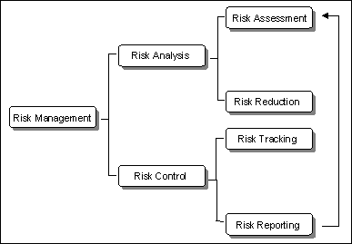
Elements of Risk Analysis
What are the risks involved in getting to work?
Reduce the occurrence and/or impact of the risk.
Identify new risks as they occur & report on all known risks.

Slide 81
Risk Management
Risk assessment
Objectives
Analyze risk in a cost-efficient manner
Determine source of risk
Determine risk exposure
Determine time frame for action
Determine highest-severity risks

Slide 82
Assessing Project Risk
Have top software and customer managers formally committed to support the project?
Are end-users enthusiastically committed to the project and the system/product to be built?
Are requirements fully understood by the software engineering team and their customers?
Have customers been involved fully in the definition of requirements?
Do end-users have realistic expectations?
Is project scope stable?
Are project requirements stable?
Does the software engineering team have the right mix of skills?
Does the project team have experience with the technology to be implemented?
Is the number of people on the project team adequate to do the job?
Do all customer/user constituencies agree on the importance of the project and on the requirements for the system/product to be built?

Slide 83
Risk Management
Reactive Risk Management
project team reacts to risks when they occur
mitigation – plan for additional resources in anticipation of fire fighting
fix on failure – resources are found and applied when the risk strikes
crisis management – failure does not respond to applied resources and project is in jeopardy
Proactive Risk Management
formal risk analysis is performed
organization corrects the root causes of risk
TQM concepts and statistical SQA
examining risk sources that lie beyond the bounds of the software
developing the skill to manage change

Slide 84
Proactive Risk Strategies
Begins long before technical work is initiated.
Potential risks are identified.
Probability and impact of risks are assessed.
Risks prioritized by importance.
Software team establishes a plan to manage the risk.

Slide 85
Qualitative Risk Analysis: Introduction
Qualitative risk analysis is concerned with prioritizing identified risks
Priority is determined by estimating a risk’s probability of occurrence and its impact on the project
Helps determine if it is necessary to perform quantitative risk analysis, a more complex analysis process
Used throughout project: it’s fast, relatively easy, and cost-effective

Slide 86
Inputs to qualitative risk analysis
Organizational process assets
Historical information from previous projects
Includes formal or informal ‘lessons learned’ as well as closure documentation and/or post mortems
Project scope statement
Identifies initially-defined risks
Risk management plan
Provides framework within which to perform risk analysis
Risk register
Provides a comprehensive enumeration and description of all project risks

Slide 87

Risk Projection
Risk projection, also called risk estimation, attempts to rate each risk in two ways
the likelihood and probability.
the consequences of the problems associated with the risk, should it occur.
The project manager performs the following risk projection activities:
Establish a scale that reflects the perceived likelihood of the risk.
Delineate the consequences of the risk.
Estimate the impact of the risk on the project.
Note the overall accuracy of the risk projection.

Slide 88
Risk Analysis
Determine impact of each risk
Risk Exposure (RE)
a.k.a. “Risk Impact”
RE = Probability of loss * size of loss
Ex: risk is “Facilities not ready on time”
Probability is 25%, size is 4 weeks, RE is 1 week
Ex: risk is “Inadequate design – redesign required”
Probability is 15%, size is 10 weeks, RE is 1.5 weeks
Statistically are “expected values”
Sum all RE’s to get expected overrun
Which is pre risk management

Slide 89
Risk Analysis
Estimating size of loss (impact)
Loss is easier to see than probability
You can break this down into “chunks” (like WBS)
Estimating probability of loss
Use team member estimates and have a risk-estimate review
Use Delphi or group-consensus techniques
Use gambling analogy “how much would you bet”
Use “adjective calibration”: highly likely, probably, improbable, unlikely, highly unlikely
Risk Prioritization
Remember the 80-20 rule
Often want larger-loss risks higher – Or higher probability items
Possibly group ‘related risks’
Helps identify which risks to ignore – Those at the bottom

Slide 90
Risk probability and impact assessment
First, assess the probability that the identified risk will occur
Second, determine the impacts of the risk on project objectives: time, scope, quality, and cost
Assessment helps determine which risks require aggressive management
Probabilities and impacts are defined in the risk management plan under the heading definitions of risk probability and impact

Slide 91
Probability and impact matrix
Defines a combination of risk probability and risk impact that helps determine which risks need detailed risk response plans
Example: A risk with a high probability of occurring and a high impact will be a strong candidate for a risk response plan
Matrix is typically defined by the organization
If organization does not define a matrix, develop one during planning meetings and analysis
We will look at the probability and impact matrix in the Qualitative Risk Analysis process, where it is used

Slide 92
Defining risk probability and impact
Probability is the potential for the risk event to occur during the course of the project ( 0 ≤ p ≤ 1)
Impact describes the consequences to the project should the risk event occur
May use subjective (high-medium-low) rating or quantitative (numeric) values
We will look at probability and impact definitions in the Qualitative Risk Analysis process, where they are used

Slide 93
Probability
Probability is the likelihood that an event will occur
Fair coin flip: 0.5 probability of getting heads, 0.5 probability of getting tails
Sum of probabilities of all outcomes adds up to 1.0
For any event e, the probability p that e will occur is 0.0 ≤ p_{e} ≤ 1.0
The complementary probability that e will not occur is just 1.0 - p_{e}
Risk probability is the probability that the risk event will occur sometime during the life of the project and is most often determined through expert judgment
Ways to improve the utility of risk probabilities
Develop consistent decision criteria for determining probabilities
Involve as many experts as you can

Slide 94
Quantifying risk probability
Most probability estimates come from experts as subjective ratings: low, medium, high, etc.
Present estimator with cardinal (numeric) scale so that a more precise estimate can be obtained
Need a quantified risk value for use in the probability and impact matrix

Slide 95
Quantifying risk probability
For most situations, use of a ﬁve-point Likert scale is appropriate:
Highly unlikely (p < 20%)
Unlikely (20% < p < 40%)
About even (40% < p < 60%)
Likely (60% < p < 80%)
Highly likely (p > 80%)
For less well-deﬁned situations, use a three-point scale:
High (p > 75%)
Moderate (35% < p < 75%)
Low (p < 35%)

Slide 96
Impact
Impact is the amount of pain or gain the risk event poses to the various project objectives: cost, time, scope, and quality
Like probability, risk impact may be characterized on a subjective scale (low, medium, high)
Like probability, a cardinal (numeric) scale of impact is needed for the probability and impact matrix
Employ consistent decision criteria when using a subjective scale
Establish a consistent means of determining what moves a borderline impact into one impact category or another
Following slide shows the (negative) impact scale from the PMBOK Guide, Third Edition

Slide 97
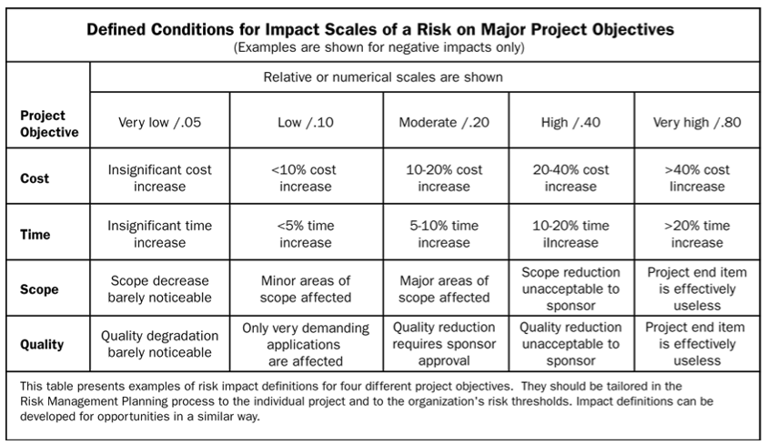
Quantifying impact

Slide 98
Risk Prioritization
How to prioritize risks?
One way to prioritize risks is to estimate the probability of its occurrence and its consequences (loss) when it does occur.
The expected value of the loss for the risk can be used for prioritization. This expected value is called risk exposure. If P_{r} is the probability of a risk R occurring and L_{r} is the total loss incurred if the risk materializes, then risk exposure RE, for the risk is given by the following equation:
RE_{r} = P_{r} X L_{r}

Slide 99
Assessing probability and impact
Probability and impact values are defined in order to readily place a value on a risk event
Use predefined probability and impact values as a starting point for a project and customize them as needed for the organization
Use brainstorming or the Delphi technique to establish or refine the probability and impact values
During Qualitative Risk Analysis process, determine and assess probability and impact for every risk identified during the Risk Identification process
Document probability and impact and any assumptions used to arrive at these values

Slide 100
Probability and impact matrix
Risk probability and impact values are nice, but what we need is a single value to characterize the combined effects of these two risk influences: the risk rating
This is what a probability and impact matrix does: it assigns an overall risk rating to each risk
The combination of probability and impact results in an ordinal (order-based) risk rating usually expressed as low, medium, or high
The PMBOK Guide also assigns a color code to each rating: low risks are green, medium risks are yellow, and high risks are red
A risk with high probability and high impact (and hence, high risk rating) warrants further analysis and a formal response plan in the Risk Response Planning process

Slide 101
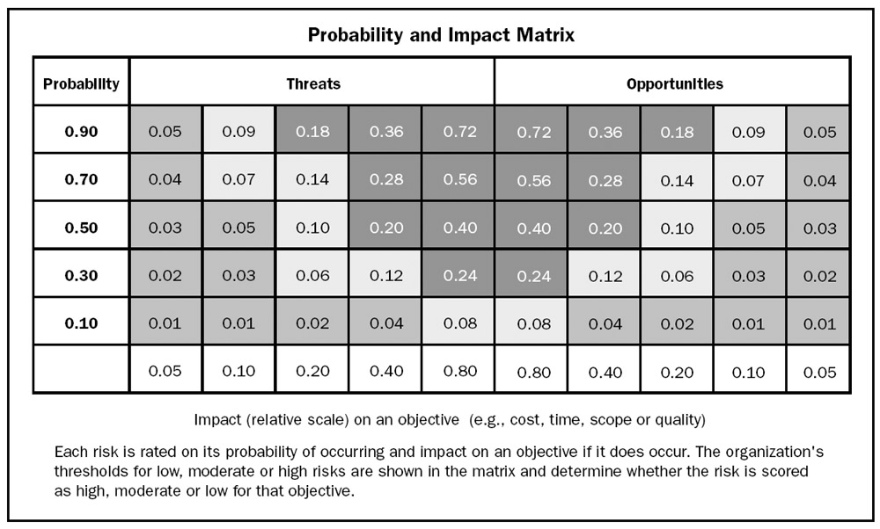
Probability and impact matrix from PMBOK Guide, Fourth Edition
Notes:
Each risk is rated on its probability of occurring and impact if it does occur. The organization’s thresholds for low (dark gray), moderate (light gray) or high (black) risk as shown in the matrix determines the risk’s score.
PMBOK Guide, 4th Edition, p. 137.

Slide 102
Example: MMS integration problems
The project management team has identified a potential problem with integrating the Membership Management System with the smart card reader software
Here’s what the team has discovered:
Five different experts agreed that the overall impact of the integration problem could result in a 5-10% delay in the project schedule
From the table in slide 82, we see a 5-10% time impact corresponds to a Moderate impact with a value of 0.20
The experts came to a consensus that there is a somewhat better than even chance that the problem will occur. The probability values the team got were: 0.6, 0.5, 0.5, 0.75, 0.5
If we take our 0.20 impact value and use it as the entry point into the probability and impact matrix on slide 86, we find that the risk rating for this event ranges from 0.10 to a bit more than 0.14, within the medium (yellow) range

Slide 103
Risk data quality assessment
Low-quality data renders qualitative risk analysis almost useless
Quality assessment examines:
Quality of data used
Availability of data for identified risks
How well the risk is understood
Reliability and integrity of data
Accuracy of data
Risk categorizations
Entries in the RBS can help identify the project phase and determine the elements of the project that are affected by risk

Slide 104
Risk urgency assessment
Do not try to deal with all risks at the same time
Analogous to rolling wave planning: determine how soon potential risks might occur
Develop risk response plan for those risks that might occur soon
For greater efficiency and effectiveness, only the top ten risks should be actively managed
Maintain a watch list of the remaining risks to replace those on the 'top 10’ list that are mitigated, controlled, eliminated, or that don't materialize

Slide 105
Outputs: Updates to the risk register
Update risk register with the following information:
Risk ranking of identified risks. Order the identified risks by risk rating
Risks grouped by categories. Identify low, medium, and high risk groups to allow easier risk urgency assessment and planning
List of risks requiring near-term responses
List of risks for additional analysis and response
Watch list of low-priority risks. Low-priority risks can still impact a project – monitor them
Qualitative Risk Analysis trends. Look for patterns that might help in response planning

Slide 106
Risk Response Planning: Introduction
Risk response planning is concerned with developing options and possible reactions to mitigate threats and exploit opportunities discovered during the risk analysis processes
The severity of the risk dictates the level of risk response planning that should be performed
A risk with low severity is not worth the time it takes to develop a detailed risk response plan
Risk responses should be cost effective
If the response cost is more than the cost of the risk, formulate a less-costly risk response

Slide 107
Risk Response Planning: Introduction
Risk responses must be timely
An untimely risk response itself becomes a risk
Risk responses must be agreed to by all the project stakeholders
Risk responses must be assigned to an individual (the risk owner) who is responsible for monitoring the risk and executing the risk response plan if needed

Slide 108
Tools and Techniques

Slide 109
Strategies for negative risks or threats
Avoidance
Risk avoidance evades a risk, eliminates the cause of the risk event, or changes the project plan to protect the project objectives from the risk event
Risk avoidance eradicates the risk by removing the risk or its cause
Risk avoidance is most suitable in the early stages of a project, through improved communications, additional resources, or more-clearly defined scope
Example: Risk of interfacing Membership Management System (MMS) to external art museum membership systems can be avoided by eliminating requirement to do so

Slide 110
Strategies for negative risks or threats
Risk transfer
Risk transfer moves the risk and the consequences of that risk to a third party
Responsibility for the management of that risk now rests with another party
Risk transfer comes in many forms but is most effective for financial risks
Example: Insurance is one form of risk transfer

Slide 111
Strategies for negative risks or threats
Contracting
Contracting is another form of risk transfer
The contractor accepts certain aspects of the risk and responsibility for the cost of failure
Types of contracts:
Fixed-price contract. Contractor increases cost of the contract to compensate for the level of risk they are accepting
Cost reimbursable contract. Contractor receives compensation for additional costs. Majority of the risk remains with the buyer [remember the VCF]

Slide 112
Risk Mitigation, Monitoring, and Management
Mitigation – how can we avoid the risk?
Monitoring – what factors can we track that will enable us to determine if the risk is becoming more or less likely?
Management – what contingency plans do we have if the risk becomes a reality?

Slide 113
Strategies for negative risks or threats
Mitigation
Risk mitigation attempts to reduce the probability of a risk event and/or its impacts to an acceptable level
Risk mitigation takes the viewpoint that fixing a problem earlier in a project is less costly than fixing it later
Examples: Performing more tests, using simpler processes, perform simulations, choose vendors for reliability over cost
Risk acceptance
The risk is acknowledged, but no action is taken unless the risk occurs
Appropriate when it is not possible or cost-effective to address a speciﬁc risk in any other way
Passive acceptance simply documents that the acceptance strategy has been adopted and leaves the project team to deal with the risks
Active acceptance establishes risk reserves, such as a pool of funds, time, or resources to be held for use in response to a risk event

Slide 114
Strategies for negative risks or threats
Risk contingency plans
Contingency planning involves planning alternatives to deal with the risks should they occur
Contingency plans do not seek to reduce the probability or impact of risks—the strategy accepts that the risk may occur and plans ways to respond to the risk
A contingency plan is executed when the risk event occurs
Contingency plans must be in place well before the time the risk may occur
Contingency (fallback) plans are developed for risks:
With very high impact or:
With response strategies that may themselves be risky
Contingency plans usually entail a signiﬁcant alternative path through part of the project
Example: disaster recovery plan

Slide 115
Contingency planning tools
Contingency allowances (or reserves). Contingency allowances provide a pool of funds, time, or resources that are held for use in response to an unavoidable risk event
Example: Including contingency time in case of loss of key personnel
Fallback plans. Fallback (or ‘Plan B’) plans are developed for risks with high impact or for risks with strategies that may in themselves be risky
Fallback plans may be used to address secondary risks
Example: Use of a relational database plus object-oriented interface in place of pure O-O database

Slide 116
Strategies for positive risks or opportunities
Exploitation
Exploitation involves looking for opportunities for positive impacts
Example: Reduce project duration by using more experienced resources on critical tasks
Sharing
Sharing is the positive analog to transferring
Sharing assigns risk to a third-party owner who is better able to use the opportunity the risk presents
Example: Form a joint venture between a technical software company and marketing and sales firm

Slide 117
Sidebar: Residual and secondary risks
Secondary risks arise as a result of implementing a risk response – they are the risks inherent in the response
Identify and plan responses for secondary risks using tools such as fallback plans
Example: O-O/RDB expert consultant becomes ill
Residual risks are those that cannot be effectively dealt with within the rest of the risk plan
Example: Some risk may remain as a result of other response plans. Residual risks are usually dealt with through contingency reserves
Example: Developer skills risks (resource planning risk) associated with alternate database solution

Slide 118
Risk response planning outputs
Risk register updates
List of identified risks, including:
Descriptions
WBS element or area of the project impacted
Categories (RBS)
Root causes
Project objectives impacted by the risk impacts
Risk owners and their responsibilities
Risk triggers – precursors to risk event; Trigger conditions, symptoms, and warning signs of a risk occurrence
Response plans and strategies
Speciﬁc actions to implement the chosen response strategy
Fallback plans if the primary response strategy proves inadequate

Slide 119
Risk response planning outputs
Risk register updates
Cost and schedule activities needed to implement risk responses
Contingency plans
Contingency plans and triggers for their execution
Contingency reserves for cost, time, and resources
Fallback plans
List of residual and secondary risks
Probabilistic analysis of the project and other outputs of the qualitative (and quantitative) risk analysis processes

